Slide 1

“Providing services to People with Disabilities”
A presentation by
Sarah Togher (IASE)

Slide 2
About Us
Who are you?
IASE is a National Voluntary Organisation which promotes employment rights and access to work for all people with a disability in Ireland.
IASE has over 900 members nationally, who in turn are working with over 5,000 people with disabilities.

Slide 3
About us
What’s your position?
Sarah Togher – National Co-ordinator
What’s the name of your organisation?
IASE (Irish Association of Supported Employment)
Where do operate geographically?
IASE provide support nationwide, with 7 regional branches/office base is in Belmullet, Co Mayo

Slide 4
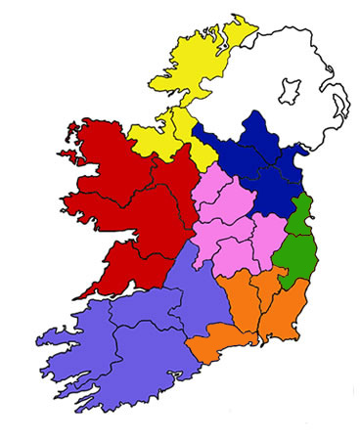
About us
BRANCHES
North West
West
Southern
Midlands
South East
East
North East
Core philosophy?
The core belief of IASE is that all people with disability who want to work can and have a right to work.

Slide 5
About Our Service
Describe the type of services you deliver
Campaigning for equal rights of people with disabilities in accessing mainstream employment opportunities with the provision of appropriate supports.
Working with Government Departments, Employer Bodies on the development and promotion of a National Inclusive Employment Strategy for all people with disabilities in Ireland.
Promoting and influencing best practice standards in the delivery of employment for all people with disabilities in Ireland.
Facilitating the exchange of information for all interested parties.

Slide 6
About our service
What makes your service different to that provided by others?
IASE is the only national umberella organisation promoting the concept of supported employment
What’s your specific expertise?
Supported Employment?
Supported Employment is a concept, which enables people with disabilities to be employed in paid jobs in the open labour market. Supported Employment provides support to job seekers with disabilities and their employers and co-workers. The support given allows individuals with disabilities to become and remain gainfully employed. People with a wide range of disabilities e.g. physical, sensory and intellectual disabilities as well as people with mental health difficulties, have become successfully employed using the Supported Employment Model.

Slide 7
Experience & Outlook
What’s your experience?
How long are you involved in the sector?
How would you like to interact with other providers in future?
What’s your special message for People with Disabilities and the audience at the event?

Slide 8
Contact Details
How can people contact you and get more information?
Contact me
Sarah Togher
email sarah@iase.ie
phone 097 82894
James McClean - North West Branch
phone 074 9129779

